Slide 1
EN 410 Energy Management
Gurubalan Annadurai
guru.a@iitb.ac.in

Slide 2
Recap
Types of energy auditing
Steps of detail energy auditing
Energy conservation measures

Slide 3
Energy monitoring, targeting and reporting
Monitoring - aims at establishing the existing pattern of energy consumption
Targeting - identifies energy consumption level for management to work towards energy conservation
Reporting - ongoing control of energy savings form, achievement of reductions targets and verification of savings
5-15% reduction in energy requirement
Measure
Analyze
Target
Action

Slide 4
Monitoring
Development of energy performance model – Quantifies the performance relationship between the independent variable with the consumption or production
Methods – Regression or simulation

Slide 5
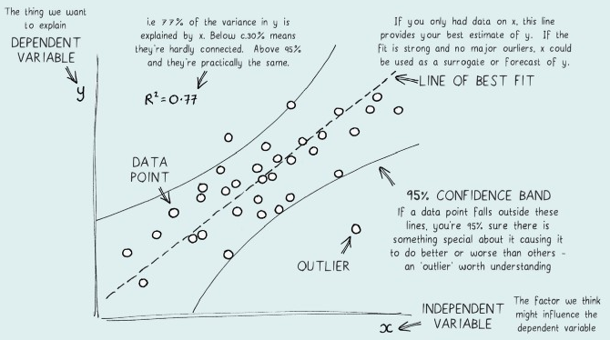
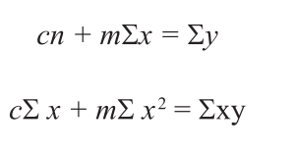
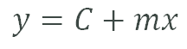
What is regression analysis?
$$y=C+mx$$

Slide 6
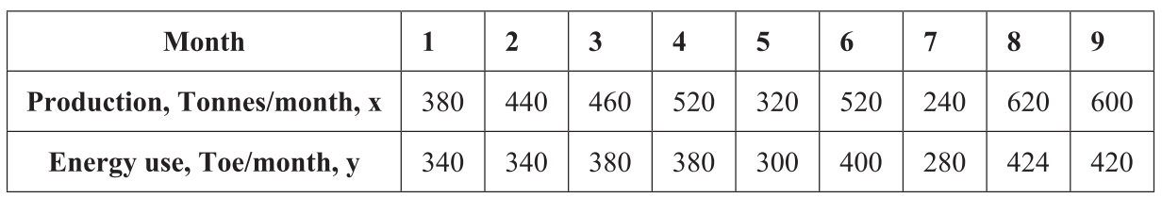
Example
$$y=C+mx$$

Slide 7
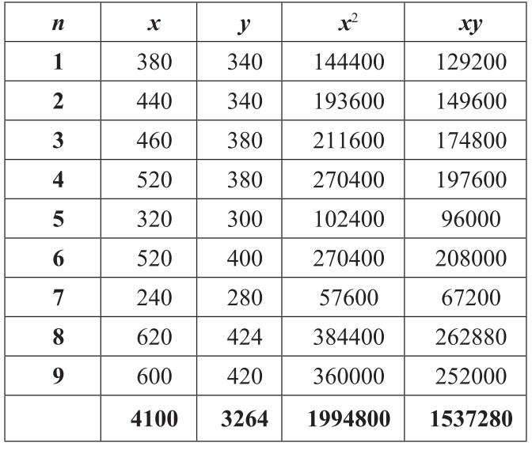
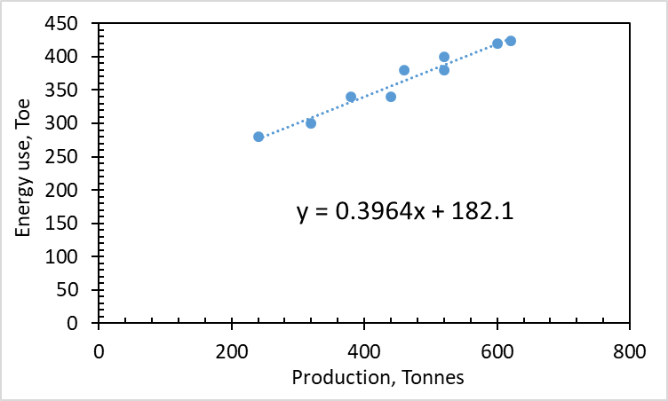
Regression analysis

Slide 8
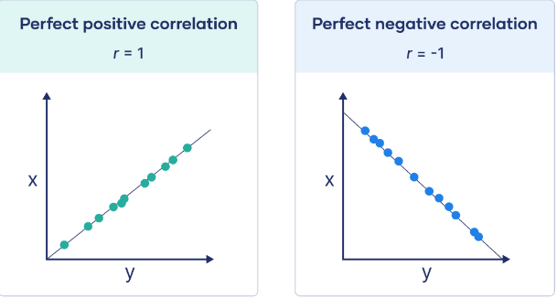
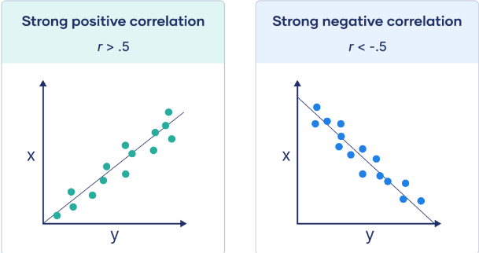
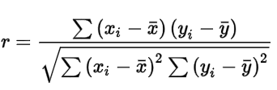
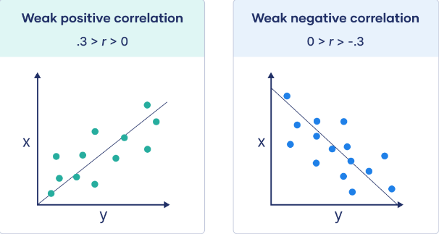
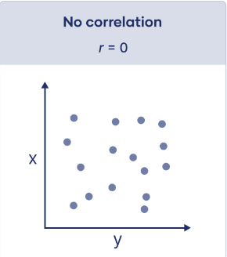
Pearson correlation coefficient
Number of data | Minimum correlation coefficient
10 | 0.767
15 | 0.641
20 | 0.561
25 | 0.506
30 | 0.464
35 | 0.425
40 | 0.402
45 | 0.38
50 | 0.362

Slide 9
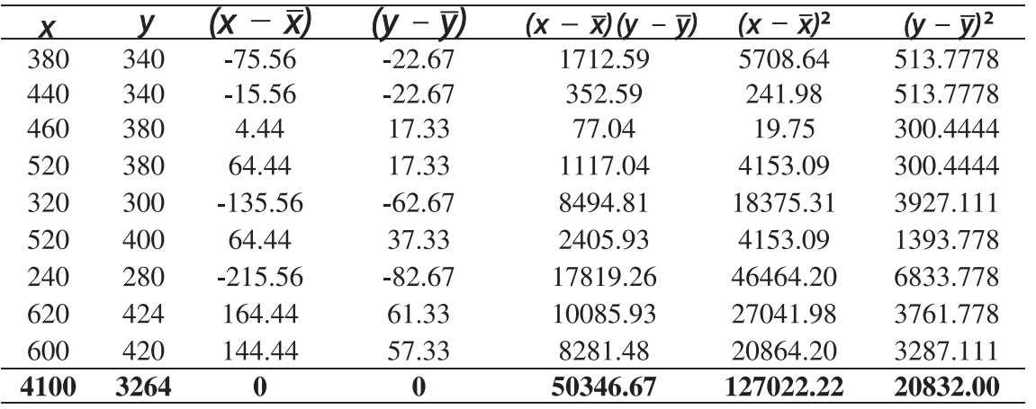
Pearson correlation coefficient
r = 0.98

Slide 10
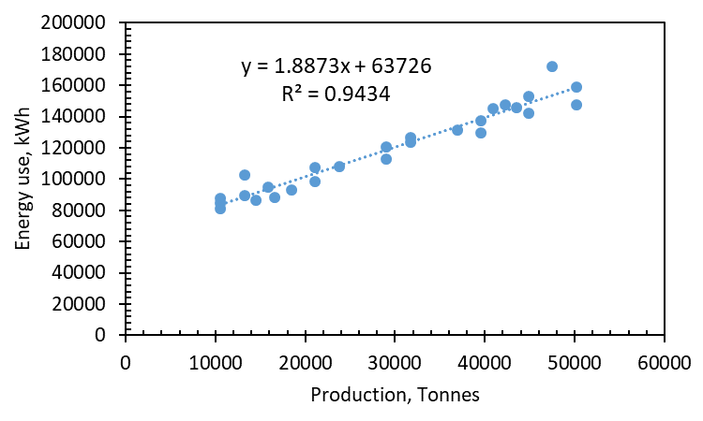
Energy data of a food processing plant
Month | Production (ton) | Total Process Energy (kWh)
1 | 39600 | 137243
2 | 21120 | 107620
3 | 15840 | 94630
4 | 13200 | 102649
5 | 44880 | 152845
6 | 47520 | 171792
7 | 31680 | 126754
8 | 10560 | 84905
9 | 29040 | 120510
10 | 23760 | 108051
11 | 10560 | 87491
12 | 13200 | 89379
13 | 36960 | 131255
14 | 40920 | 144886
15 | 43560 | 145882
16 | 50160 | 158760
17 | 10560 | 81102
18 | 14520 | 86234
19 | 39600 | 129613
20 | 21120 | 98710
21 | 16632 | 88233
22 | 29040 | 112643
23 | 18480 | 92912
24 | 44880 | 142198
25 | 50160 | 147453
26 | 42240 | 147231
27 | 31680 | 123359

Slide 11
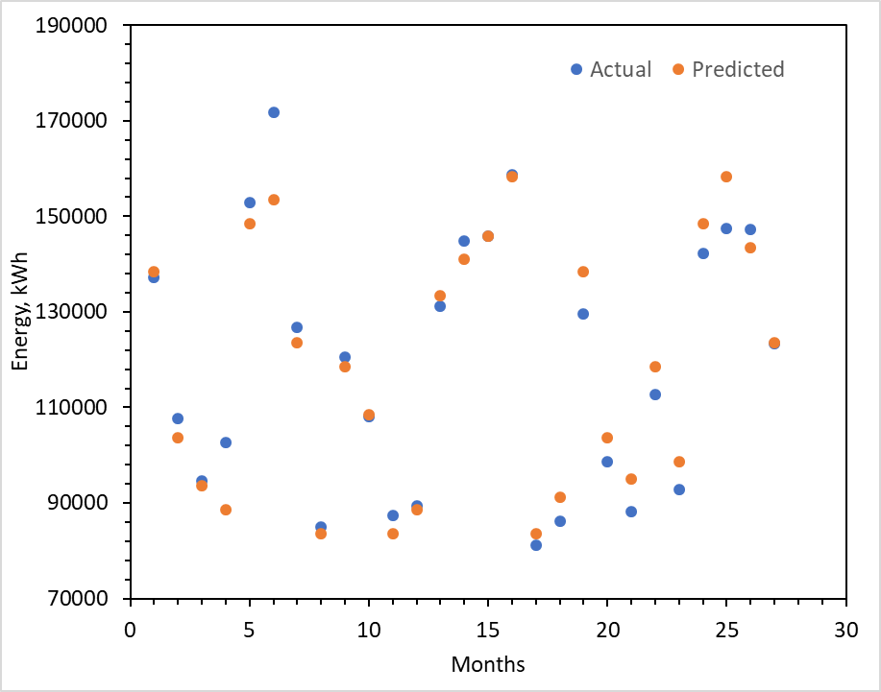
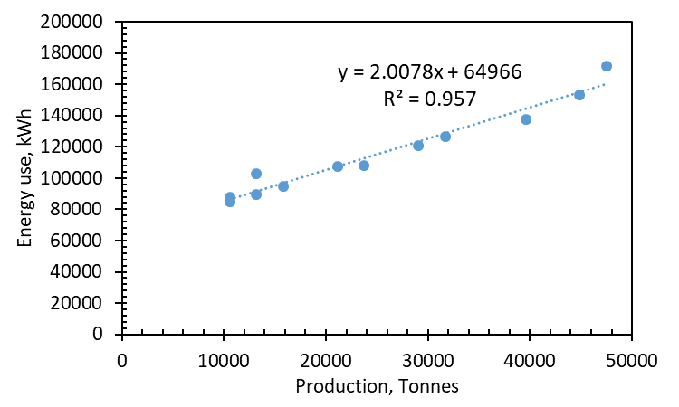
Energy data of a food processing plant
Essential to develop the baseline by analyzing the data (not necessarily the first year data..)

Slide 12
CUMSUM Analysis
Cumulative Sum – Difference between baseline (expected/standard) consumption and actual consumption over a period of time
Provides trend line, Savings/ Losses
Helps detect impact of energy conservation opportunities, deterioration of plant performance
Should oscillate around zero after new target

Slide 13
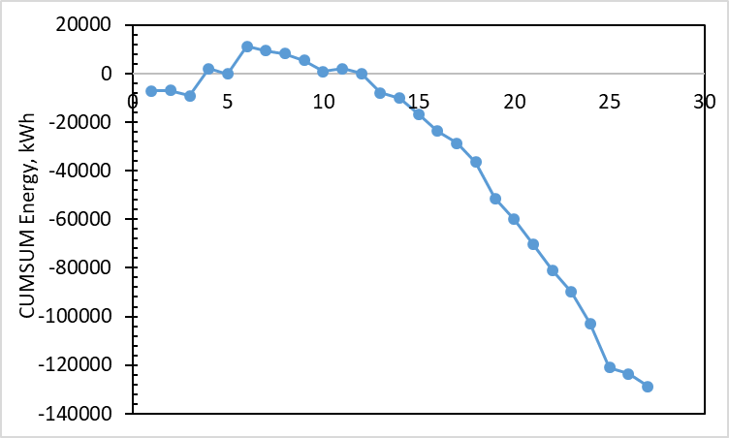
CUMSUM Analysis
Month | Production (ton) | Total Process Energy (kWh) | Baseline prediction | Variance | CUMSUM Energy
1 | 39600 | 137243 | 144474.9 | -7231.88 | -7231.88
2 | 21120 | 107620 | 107370.7 | 249.264 | -6982.62
3 | 15840 | 94630 | 96769.55 | -2139.55 | -9122.17
4 | 13200 | 102649 | 91468.96 | 11180.04 | 2057.872
5 | 44880 | 152845 | 155076.1 | -2231.06 | -173.192
6 | 47520 | 171792 | 160376.7 | 11415.34 | 11242.15
7 | 31680 | 126754 | 128573.1 | -1819.1 | 9423.048
8 | 10560 | 84905 | 86168.37 | -1263.37 | 8159.68
9 | 29040 | 120510 | 123272.5 | -2762.51 | 5397.168
10 | 23760 | 108051 | 112671.3 | -4620.33 | 776.84
11 | 10560 | 87491 | 86168.37 | 1322.632 | 2099.472
12 | 13200 | 89379 | 91468.96 | -2089.96 | 9.512
13 | 36960 | 131255 | 139174.3 | -7919.29 | -7909.78
14 | 40920 | 144886 | 147125.2 | -2239.18 | -10149
15 | 43560 | 145882 | 152425.8 | -6543.77 | -16692.7
16 | 50160 | 158760 | 165677.2 | -6917.25 | -23610
17 | 10560 | 81102 | 86168.37 | -5066.37 | -28676.3
18 | 14520 | 86234 | 94119.26 | -7885.26 | -36561.6
19 | 39600 | 129613 | 144474.9 | -14861.9 | -51423.5
20 | 21120 | 98710 | 107370.7 | -8660.74 | -60084.2
21 | 16632 | 88233 | 98359.73 | -10126.7 | -70210.9
22 | 29040 | 112643 | 123272.5 | -10629.5 | -80840.4
23 | 18480 | 92912 | 102070.1 | -9158.14 | -89998.6
24 | 44880 | 142198 | 155076.1 | -12878.1 | -102877
25 | 50160 | 147453 | 165677.2 | -18224.2 | -121101
26 | 42240 | 147231 | 149775.5 | -2544.47 | -123645
27 | 31680 | 123359 | 128573.1 | -5214.1 | -128859
Analyze the slope
Best between 18 to 24 months

Slide 14
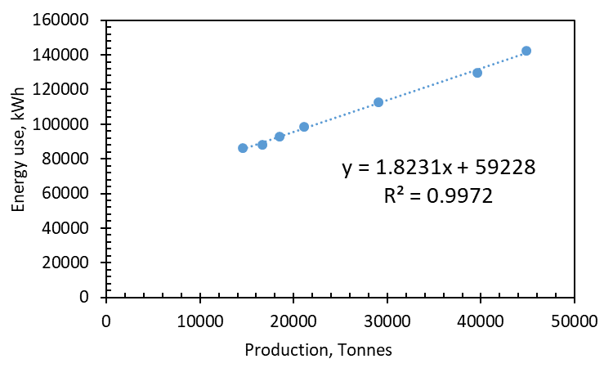
Energy consumption data
Parameter | Baseline | Month 18-24 | % Improvement
Slope (production dependent consumption) | 2.0078 | 1.8231 | 9.2
Intercept (production independent consumption) | 64966 | 59228 | 8.83

Slide 15
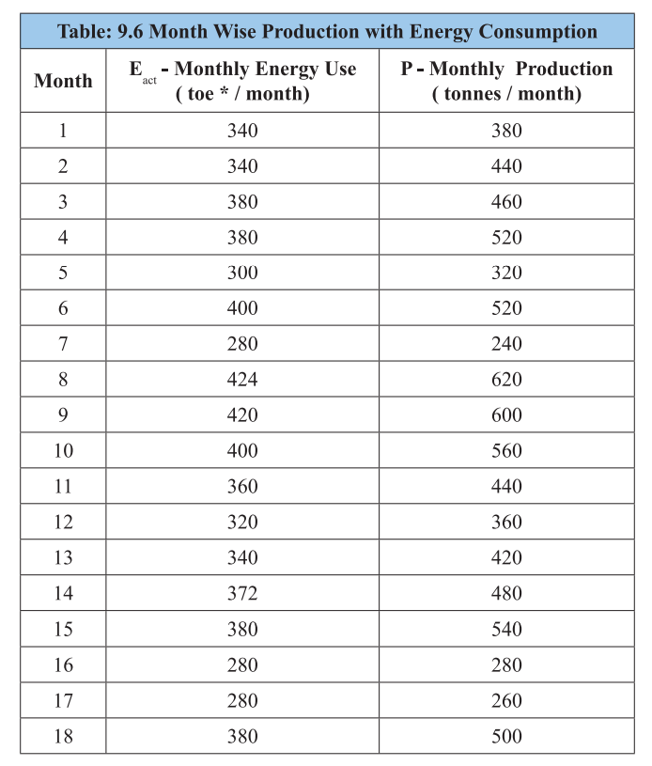
CUMSUM Analysis

Slide 16
Target and control
Maintain the performance (e.g., 18-24 month)
Eliminating the highest or least efficient points
Defining the best from the historical data
Developing control chart according to the target for each process / equipment / system (= 1.4 times of average variance)

Slide 17
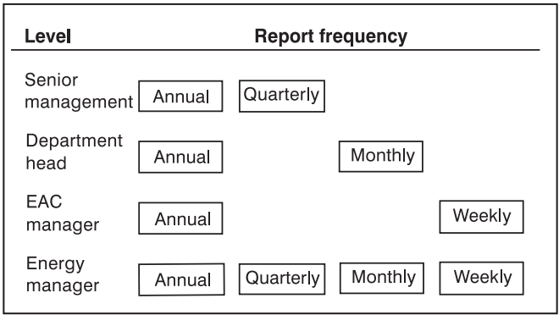
Reporting
Essential for mentoring the savings by different level of personnel
Summary
Management
Reports and budget
Supervisor
Data collection and analysis
Control info
Operators
Measure
Action
Energy consuming system

Slide 18
Energy Benchmarking
Energy Benchmark is the achievable most energy efficient reference point for comparative evaluation
Highly effective tool for energy efficiency improvements provided comparisons are made on equivalent basis.
Provides data on how energy is currently used within a particular industrial sector or building type

Slide 19
Energy Benchmarking
Industrial Benchmarking types
Entire industrial sector (for national use)
How much the sector is performing when compared the best technologies
When compared to the other countries
Improvement over time
Comparing plants within the sector
Critical since it contain the proprietary information
Comparing within the plants
Most used since securing the data

Slide 20
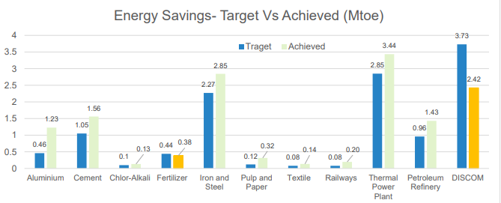
Energy Benchmarking – Within Country PAT Scheme

Slide 21
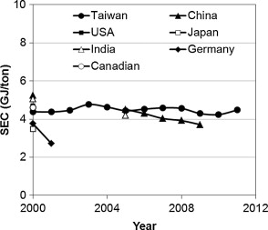
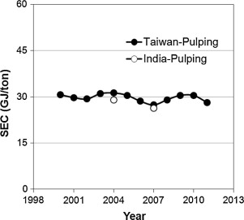
Energy Benchmarking – Among countries
Energy intensity (SEC) in cement industry
Pulp industry

Slide 22
Recap
MT and R process – Elements, steps
Regression analysis
CUMSUM Technique
Energy benchmarking

Slide 23
Refrences
https://www.sankey-diagrams.com/engine-efficiency-of-cars/
https://www.sciencedirect.com/science/article/pii/S0196890413005645#s0015
https://beeindia.gov.in/sites/default/files/publications/files/Impact%20Assessment%202021-22_%20FINAL%20Report_June%202023.pdf

